Slide 1
Intermediate Python: Updating Anaconda Navigator
Data Structures, Algorithms & Object-Oriented Programming

Slide 2
Updating Anaconda Navigator
If you did not see the update button in the last lecture, then you need to install and updated anaconda navigator from the command line.
If you are on a Mac, open up the “Terminal” application.
If you are on a Windows machine, open up the “Anaconda Prompt” (you can search for this from your Start menu).

Slide 3
Updating Anaconda Navigator
We will now do the following four things:
Update conda (conda is the package manager for the Anaconda distribution)
Update all installed packages
Install/update anaconda-navigator
Install/update navigator-updater

Slide 4
Updating Anaconda Navigator
Update Conda:
In your Terminal, or Anaconda Prompt window, type “conda update conda” and hit enter.
Wait a few minutes, and when the prompt to proceed with the installation appears, type the ’y’ key and hit enter to continue. Feel free to read the text that appears, it will tell you what version of conda you will be updating to.

Slide 5
Updating Anaconda Navigator
Update all installed packages:
In your Terminal, or Anaconda Prompt window, type “conda update --all” and hit enter.
Wait a few minutes, and eventually you will see a print of all the packages that will be installed, updated, or even downgrade (that is ok). Type in ‘y’ and hit enter when prompted to continue the installation.

Slide 6
Updating Anaconda Navigator
Install/update anaconda-navigator:
In your Terminal, or Anaconda Prompt window, type “conda install anaconda-navigator” and hit enter.
This will either update the Anaconda Navigator you already have installed, or install a new copy if you do not have it installed within your base environment. This is 100% fine either way!
Wait a few minutes, and eventually you will see a print of the version of Anaconda Navigator that will be installed. Type in ‘y’ and hit enter when prompted to continue the installation.

Slide 7
Updating Anaconda Navigator
Install/update navigator-updater:
In your Terminal, or Anaconda Prompt window, type “conda install navigator-updater” and hit enter.
Wait a few minutes, and eventually you will see a print of the version of navigator-updater that will be installed. Type in ‘y’ and hit enter when prompted to continue the installation.

Slide 8
Launch Anaconda Navigator From The Command Line
Now, in the Terminal (mac) or Anaconda Prompt (Windows), type the following: “anaconda-navigator” and hit enter.
You just launched anaconda-navigator from the command line. This is important! You want to launch the version you just installed. You will always need to open it in this way, going forward.
Now, a window may appear and prompt you to update Anaconda Navigator, go ahead and update, this may take a few minutes.
You also may have an ‘update’ button in the upper right hand corner of Anaconda Navigator. You can go ahead and press this and follow the instructions.

Slide 9
Launch Anaconda Navigator From The Command Line
At this point, you should see the vscode square (as shown in screenshot on the next slide). You should also see an ‘Install’ button in the square. Press that button to install vscode.

Slide 10
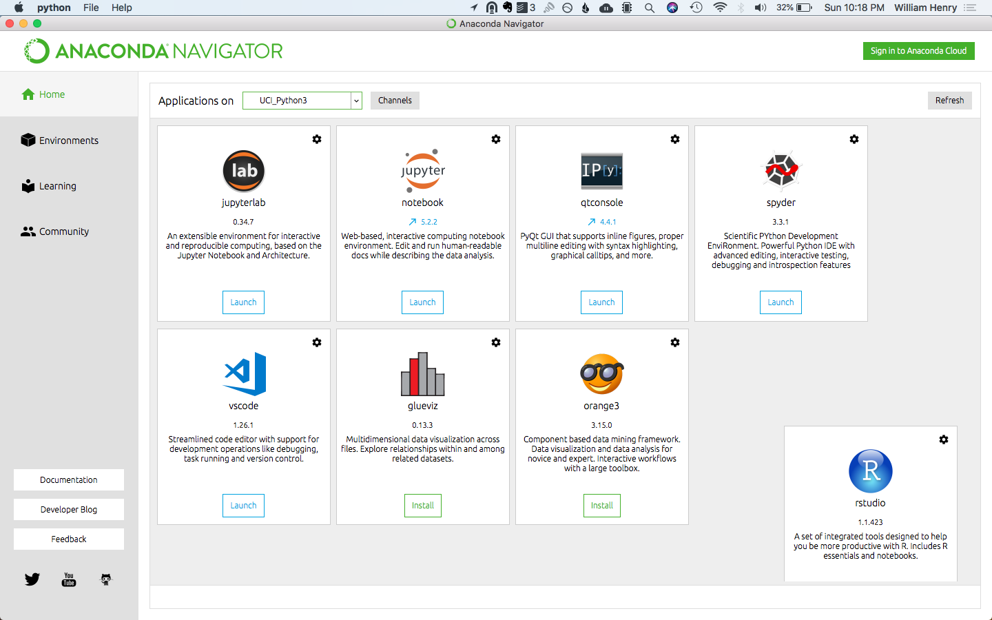
Anaconda Navigator

